Slide 1

MambaVision: A Hybrid Mamba-Transformer Vision Backbone

Slide 2
Current Vision Architecture Limitations
CNNs (ResNet, EfficientNet)
Vision Transformers (ViT)
✅ Excellent local feature extraction
✅ Global attention and long-range modeling
❌ Limited receptive field for long-range dependencies
❌ Quadratic complexity O(n²) with sequence length
❌ Hierarchical but not globally aware
❌ Computationally expensive for high-resolution images
The Challenge: Efficiency vs. Performance trade-off
Fast models: Limited representational capacity
Accurate models: Computationally prohibitive

Slide 3
What is Mamba?
State Space Models (SSMs) Foundation:
h(t) = Ah(t-1) + Bx(t) # State evolution
y(t) = Ch(t) + Dx(t) # Output generation
Key Innovation: Selective State Spaces
Dynamic Parameters
Linear Complexity
Selective Memory
A, B, C matrices depend on input
O(n) instead of O(n²) for attention
Forget irrelevant, remember important information
Why Mamba Works:
Efficiency: Linear scaling with sequence length
Selectivity: Input-dependent parameter selection
Hardware Friendly: Efficient parallelization
Long Sequences: Handles very long contexts effectively
Visual Analogy: Like a smart camera that adjusts focus based on what's important

Slide 4




The MambaVision Innovation
Core Innovation: Hybrid Architecture Design
Early Layers
Late Layers
Hierarchical Structure
Efficient feature extraction (CNN)
Transformer blocks for global understanding
Multi-scale feature representation
Mamba Strengths:
Transformer Strengths:
Linear complexity for processing large feature maps
Global attention for capturing long-range dependencies
Efficient local and medium-range feature interaction
Rich representational capacity
Memory-efficient sequence modeling
Proven success in vision tasks
Synergy Effect:
- Mamba handles the "heavy lifting" of efficient feature processing
- Transformers add global reasoning capabilities
- Together: Best of both worlds

Slide 5
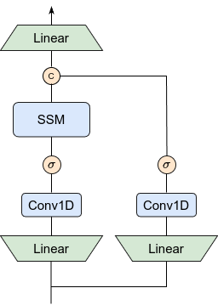
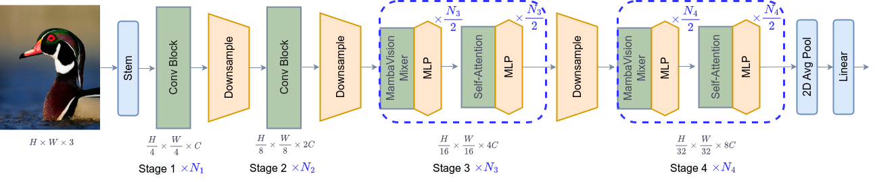
Architecture Overview
1
2
MambaVision Architecture Components:
Patch Embedding Layer
Hybrid Block Structure
Input Image (224×224×3) → Patches (16×16) → Tokens (196×embed_dim)
Mamba Blocks: Linear complexity, efficient local processing
Uses CNN-based patch embedding for efficiency
Transformer Blocks: Global attention, rich representation
Configurable Ratio: Adjustable balance between Mamba and Transformer layers
3
Strategic Placement
Mamba blocks early for efficient feature extraction
Transformer blocks late for global understanding
Flexible design adaptable to different computational budgets

Slide 6
Performance Results
ImageNet-1K Classification Results:
Model
Parameters
Top-1 Accuracy
Efficiency
MambaVision-Tiny
3.2M
81.5%
High
MambaVision-Small
22.0M
84.3%
High
ViT-Small
22M
79.8%
Medium
ResNet-50
25M
76.1%
High
Downstream Task Performance:
Object Detection (MS COCO):
Semantic Segmentation (ADE20K):
Competitive mAP with significantly fewer parameters
Superior performance on fine-grained segmentation
Faster inference due to linear complexity
Efficient processing of high-resolution feature maps
Key Performance Insights:
Efficiency: Better throughput than comparable ViTs
Scalability: Performance improves with model size
Versatility: Strong across multiple vision tasks

Slide 7
Comparative Analysis
Performance & Complexity Metrics
Understanding the computational trade-offs between different vision architectures is crucial for making informed design decisions in modern deep learning systems.
Architecture
Attention Complexity
Memory Usage
Long-Range Modeling
Overall Efficiency
CNN
O(1)
Low
Limited
High
Vision Transformer
O(n²)
High
Excellent
Medium
MambaVision
O(n)
Medium
Excellent
High
Architectural Trade-offs
CNNs (ResNet, EfficientNet)
Pure Vision Transformers
MambaVision (Hybrid)
Advantages:
Advantages:
Advantages:
Very efficient computation
Excellent global modeling capabilities
Linear complexity with global modeling
Well-optimized hardware support
Flexible attention mechanisms
Best of both architectural paradigms
Proven reliability in production
Superior long-range understanding
Efficient memory utilization
Limitations:
Limitations:
Considerations:
Limited global context awareness
Quadratic computational complexity
Newer paradigm requiring optimization
Receptive field constraints
Memory intensive operations
Learning curve for implementation
Struggles with long-range dependencies
Challenging for resource-constrained environments
Evolving best practices

Slide 8







Comparisons with Other Hybrid Architectures
The evolution of vision architectures has been marked by innovative hybrid approaches, each combining the best of different paradigms to achieve superior performance and efficiency.
ConVNeXt (2022)
Swin Transformer (2021)
MambaVision (2025)
CNN backbone redesigned with Transformer-inspired components
Hierarchical Transformer using shifted windows
Hybrid of State Space Models (Mamba) + Transformers
✅ Balances local and global feature modeling
✅ Linear complexity with strong global reasoning
✅ Simplified and efficient (depthwise conv, inverted bottlenecks, GELU, LayerNorm)
✅ Scales well for large-scale vision tasks
✅ Combines CNN-like efficiency with Transformer-level representation
✅ Competitive performance with ViT/Swin
❌ Attention still quadratic within windows, less efficient than linear models
⚠️ New paradigm, ecosystem and tooling still maturing
❌ Still convolution-centric, limited flexibility for global context
Key Insight: The Hybridization Trend
MambaVision continues the hybridization trend in vision backbones:
ConVNeXt = CNNs adapted with Transformer ideas
Swin = Transformers adapted with CNN hierarchy
MambaVision = State Space Models + Transformers → linear scaling + global modeling
CNN Foundation
Transformer Innovation
Hybrid Excellence
Traditional convolutional approaches with local feature extraction
Global attention mechanisms revolutionizing vision tasks
State-of-the-art models combining the best of both worlds

Slide 9
Limitations & Challenges
Current Limitations:
Implementation Maturity
Hardware Optimization
Understanding and Debugging
Newer paradigm, fewer optimizations
Not yet fully optimized for all hardware
Complex hybrid dynamics
Requires expertise in both paradigms
Limited ecosystem and tooling
Requires careful memory management
Ongoing research and development
Limited interpretability tools
Still evolving best practices
Future Directions:
- Advanced selective scan implementations
- Hardware-specific optimizations
- Extended architectural variants
- Better interpretability tools

Slide 10




Practical Applications
Primary Applications:
1
Image Classification
2
Object Detection
Medical imaging diagnosis
Autonomous vehicle perception
Satellite image analysis
Security and surveillance systems
Industrial quality control
Retail analytics and inventory
Content moderation systems
Robotics and automation
3
Semantic Segmentation
Medical image segmentation
Remote sensing and mapping
Autonomous navigation
Augmented reality applications
Industry Impact:
Healthcare
Autonomous Systems
Edge Computing
Faster medical image analysis with maintained accuracy
Efficient real-time perception
Mobile device deployment, IoT applications

Slide 11
Research Impact & Future Work
Research Contributions:
Future Research Directions:
Architectural Innovation
Architectural Exploration
1
First successful Mamba-Transformer hybrid for vision
Different hybrid arrangements and ratios
Systematic study of optimal block arrangements
2
Optimization and Deployment
Comprehensive ablation studies
Multi-scale and hierarchical variants
Hardware-optimized implementations
Efficiency Breakthrough
Task-specific architectural adaptations
Quantization and compression techniques
Linear complexity global modeling
New paradigm for efficient vision architectures
Application Expansion
3
Edge deployment strategies
Bridge between sequence models and computer vision
Video understanding and temporal modeling
Empirical Validation
3D vision and point cloud processing
State-of-the-art results across multiple benchmarks
Multi-modal learning integration
Demonstrates practical viability
Opens new research directions

Slide 12
Conclusion & Takeaways
Key Insights from MambaVision
01
02
03
Paradigm Shift
Technical Innovation
Practical Impact
Hybrid architectures represent the future of deep learning
State space models successfully adapted for computer vision
Immediate applications in industry and research
Strategic combination outperforms pure approaches
Linear complexity achieves global modeling capabilities
Enables new possibilities for edge and mobile deployment
Efficiency and performance are no longer mutually exclusive
Flexible design enables task-specific optimizations
Foundation for next-generation vision systems
Why MambaVision Matters
For Researchers
For Practitioners
New research direction combining SSMs and transformers
Production-ready efficient vision backbone
Template for future hybrid architecture exploration
Balanced performance and computational requirements
Efficient alternative to transformer-heavy models
Flexible architecture for diverse applications
The Bigger Picture
MambaVision represents a fundamental shift toward intelligent architectural design - strategically combining the best aspects of different paradigms rather than relying on single architectural approaches.
This hybrid approach signals a new era in computer vision where efficiency meets performance, opening doors to applications previously limited by computational constraints while maintaining the sophisticated modeling capabilities required for complex visual understanding tasks.

